Slide 1
Basic Details of the Team and Problem Statement
Problem Statement Title :
Prescription Medication Price Comparison and Healthcare Assistant
Team Name :
Suvidha
Team Leader Name :
Ankit Gupta
Institute Name :
Gyan Ganga College of Technology, Jabalpur ( Madhya Pradesh)

Slide 2
Content
Introduction
Pu﻿rpose
Approach to address the problem
Software requirement specification(functional & Non-functional requirements)
Use case diagrams ( any UML diagrams to explain the project)
Prototype(technology details, screen shots of the project can be shown during presentation)
Future work

Slide 3
Idea/Approach Details
Problem Statement : Challenges in medication pricing, safety, and accessibility demand a solution like the Medication Price Comparison Tool for user empowerment.
Solution : The Medication Price Comparison Tool is a transformative healthcare solution, simplifying the search for affordable prescription medications, providing vital information about generic alternatives, ensuring medication safety, and enabling easy price inquiries. In a healthcare landscape marked by complexity and opacity, our tool empowers users to make informed decisions. Its unique feature of identifying medications from photos streamlines access to real-time pricing and age suitability data. Users can also request prices for unavailable medicines, fostering collaboration. Virtual healthcare consultations and hospital recommendations further reduce healthcare costs. Medication reminders and delivery requests enhance adherence, promoting overall well-being and cost-effective healthcare decisions.

Slide 4
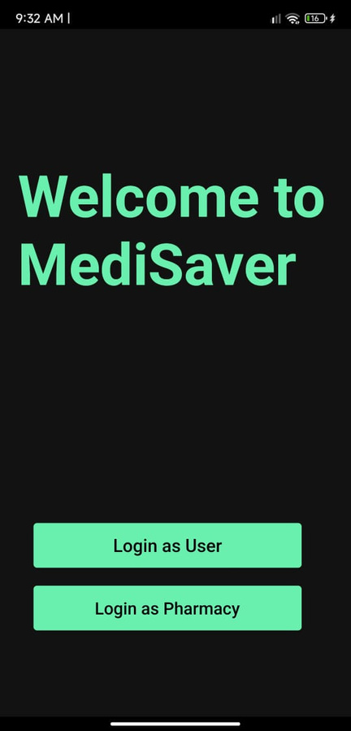
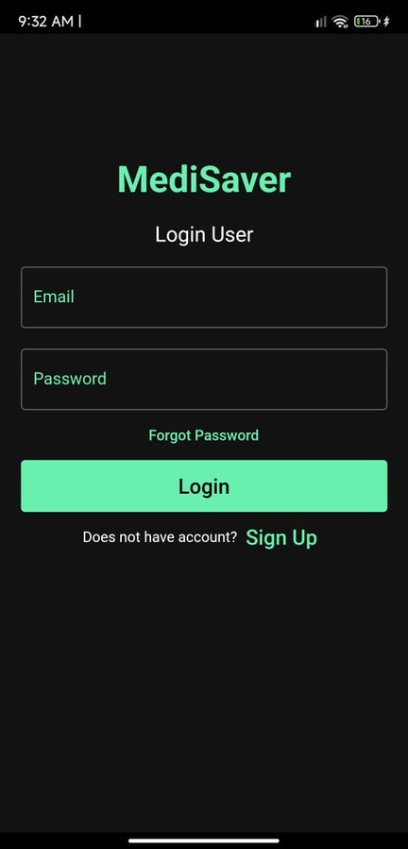



Prototype
Technology Stack

Slide 5
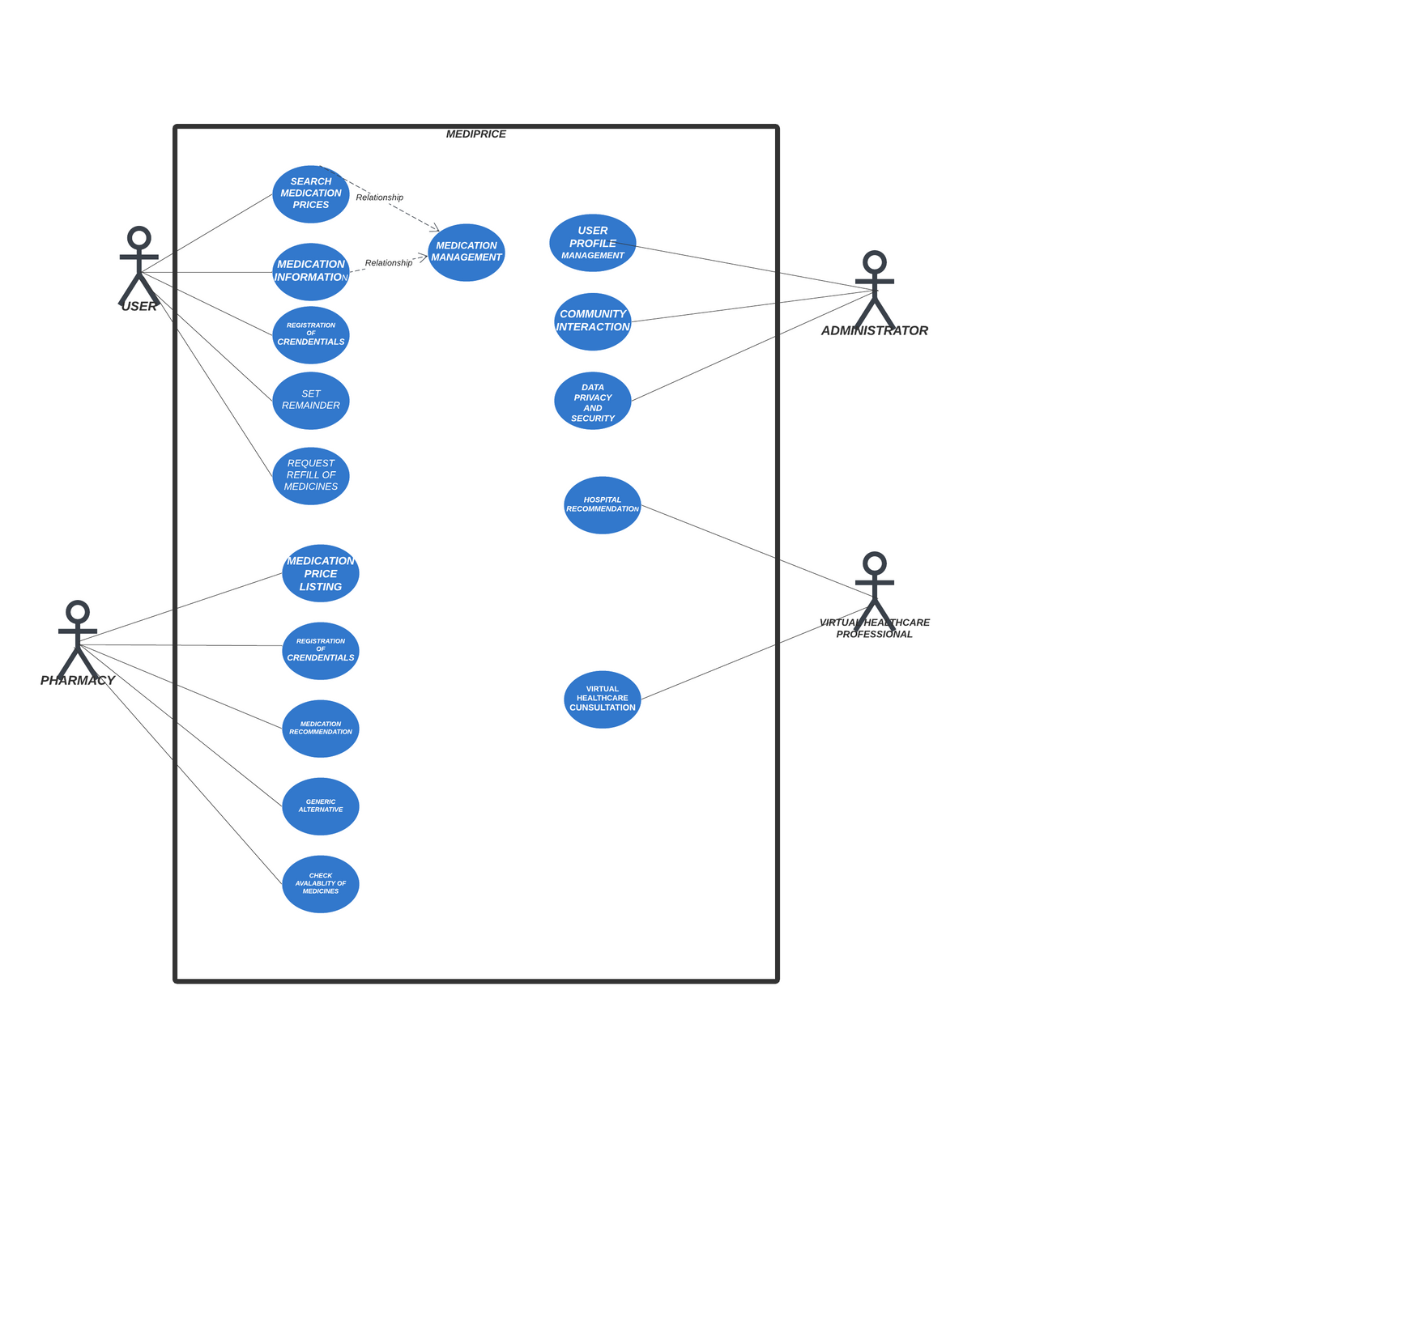
Uses Cases
Dependencies
Google API to fetch Nearby Medical Shop
Future Enhancement
Virtual Healthcare Consultation Service

Slide 6
Team Member Details
Team Members
Branch
Stream
Year
Position in Team
S. No.
1.
Ankit Gupta
B.tech
CSE
Third
Team Leader
2.
Jay Chourasiya
B.tech
CSE
Third
Model Testing
3.
Ashwani Vishwakarma
B.tech
CSE
Third
Back End Developer
4.
Nidhi Sharma
B.tech
CSE
Third
Front End Developer
Team Mentor Details
Name of Mentor
Category
Expertise
Domain Expertise
S. No.
Prof. Prashant Kostha
Academics
Cloud Computing
GCloud
1.

